Slide 1




Affirma consulting is the consulting firm that cares. Our strength is in our passionate, knowledgeable and happy team members. We believe and are living proof that when you take care of your employees – they will take care of your customers. Our team members care about your project success – and it shows.
See how their enthusiasm and knowledge can benefit you!

Slide 2
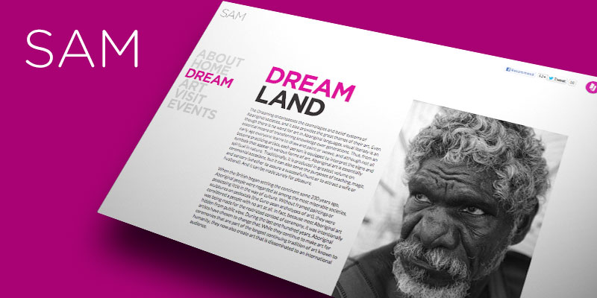
Seattle Art Museum Website
The Challenge
<p>The Seattle Art Museum needed a way to revamp the way they managed content on their site and needed to replace the use of simple static HTML.</p>
What We Did
<ul>
<li>We replaced the back end of their public website site with Microsoft SharePoint so they could easily manage their important content with a more consistent look and feel.</li>
</ul>
Results
<p>SAM is very happy with the design improvements, ease of use, utilization of list-driven web parts to manage content which requires little to no formatting. Since making the shift to the new design, the website has a more consistent look and feel as well as enhanced functionality. Our client is saving many hours each day due to to their improved ability to manage content on their site.</p>

